Slide 1

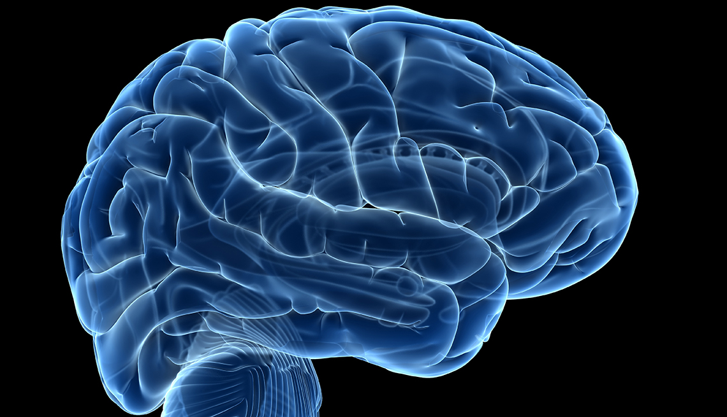
AI 3 years in: Lots of progress, Lots of issues !
Gord Larose
Presented to CFUW
Feb 3 2026
Notes:
First off, this is huge and fast-moving field and I won’t be up to the minute or cover more than a part of it, even though this presentation is a bit longer than I hoped!

Slide 2



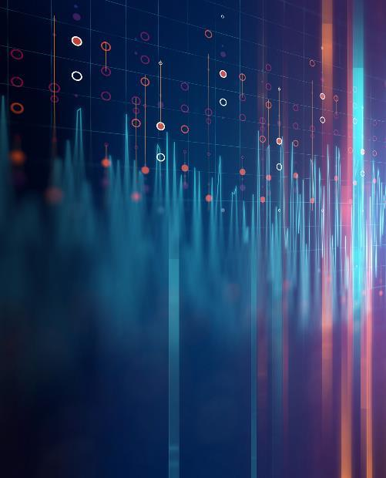
A brief history of AI
The notion of AI – machines who think – long predates computers. In the last 80 years as computers have advanced dramatically the idea of thinking machines is no longer fantasy.

Slide 3
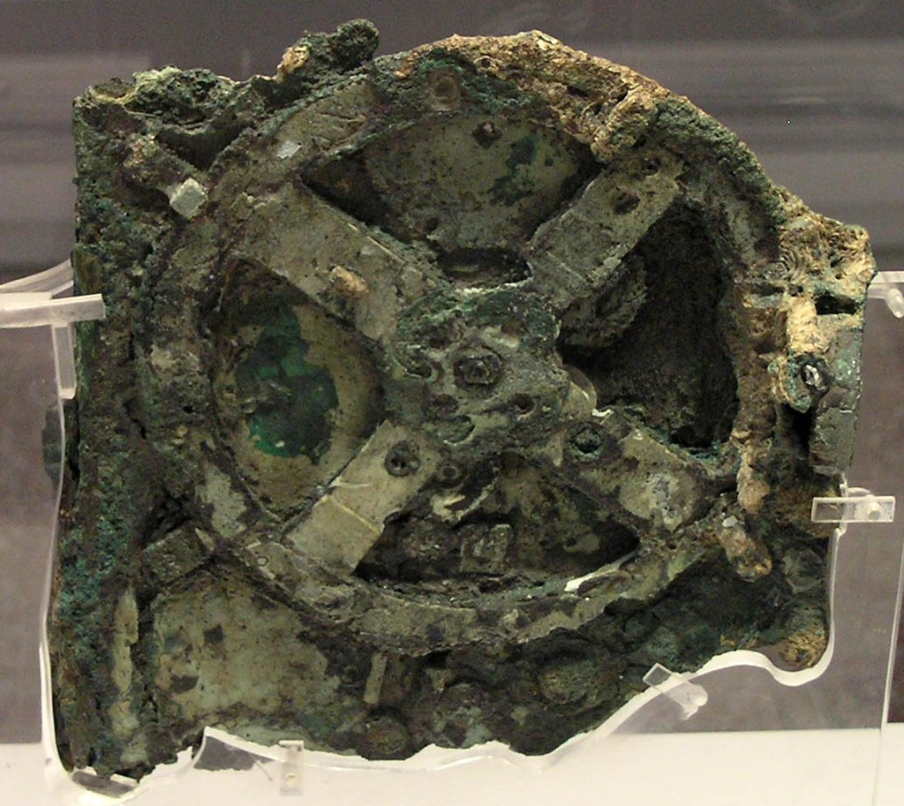
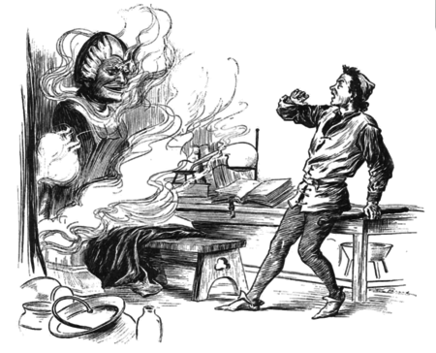
Prehistory – 1920s: Myths & Machinery
Greece: The Colossus of Rhodes, Talos, Antikythera Mechanism
Middle ages: -water-powered automatons in the Islamic world -Roger Bacon’s Brazen Head – the first chatbot!
17th Century: Babbage’s Difference Engine
“Rossum’s Universal Robots” play of 1920 The word robot comes from a Czech word for “laborer”
Some of these could “calculate” but they made no real attempt at “intelligence”
Notes:
Most of these efforts were mechanical machines and the rare ones with intelligence had a midget hidden in the works. In the related mythology, clockwork or corpse-based machinery was “brought to life” by adding some sort of essence – a soul, a zap of electricity – to put a “ghost in the machine”. No-one thought that the machine per se could be intelligent.

Slide 4
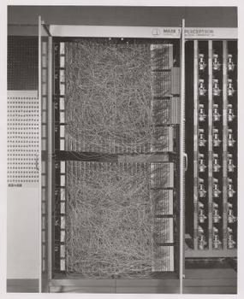
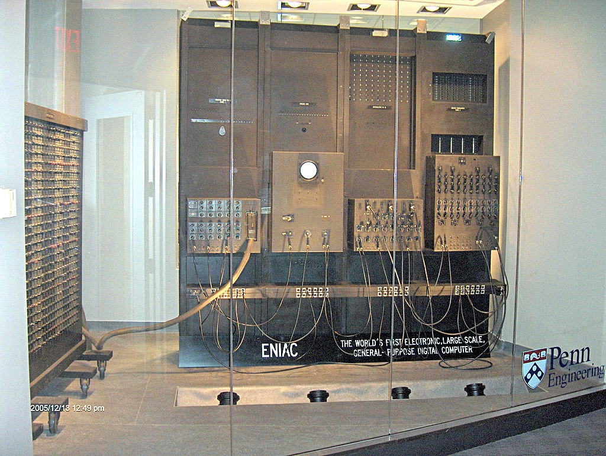
1930s-1956: Real computers, imagining AI
The earliest “computer” designs were modeled on both brains and calculators!
Perceptron: 1943-1958 The first “artificial neurons” mimicking about 500 cells of the human brain – which has about 100 billion connected neurons.
ENIAC: 1943 The first “general purpose programmable” digital computer.
The “Turing Test”, 1950 Could a machine fool you into thinking it was human?
The Dartmouth Conference, 1956 Could a bunch of smart guys crack AI in a summer?
Notes:
Arguably the Turing Test has already been passed, a 2014 chatbot pretended to be a 13-year-old boy (Eugene Goostman) and fooled about 1/3 of the humans who tried it. This is not the mission of current chatbots but if one were tuned that way it would probably fool many more humans. There is an inherent element of deception in this, which introduces practical as well as ethical challenges. Could YOU convincingly pretend to be a 13-year-old European boy?

Slide 5

1957 ~ 2000: AI flounders
Hype cycles, academic squabbles, competing paradigms, funding booms & busts
“AI Programming”: symbolic logic (LISP, PROLOG)
ELIZA, The Rogerian Therapist Chatbot (1966)
Expert systems, “Fifth Generation” computing
Early neural networks aka “connectionism” Sometimes with dedicated HW, sometimes simulated Hundreds or thousands of “Neurons” – not enough
NONE OF THIS REALLY WORKED! INTELLIGENCE IS HARD!
Notes:
Deterministic AI (if-then logic, search trees, production systems etc.) consistently failed to seem intelligent. It’ just too hard to explicitly program intelligence. And neural networks systems of the era were just too small to exhibit interesting behavior – you had to simulate MILLIONS or BILLIONS of neurons which could be done with the hardware of the era.

Slide 6
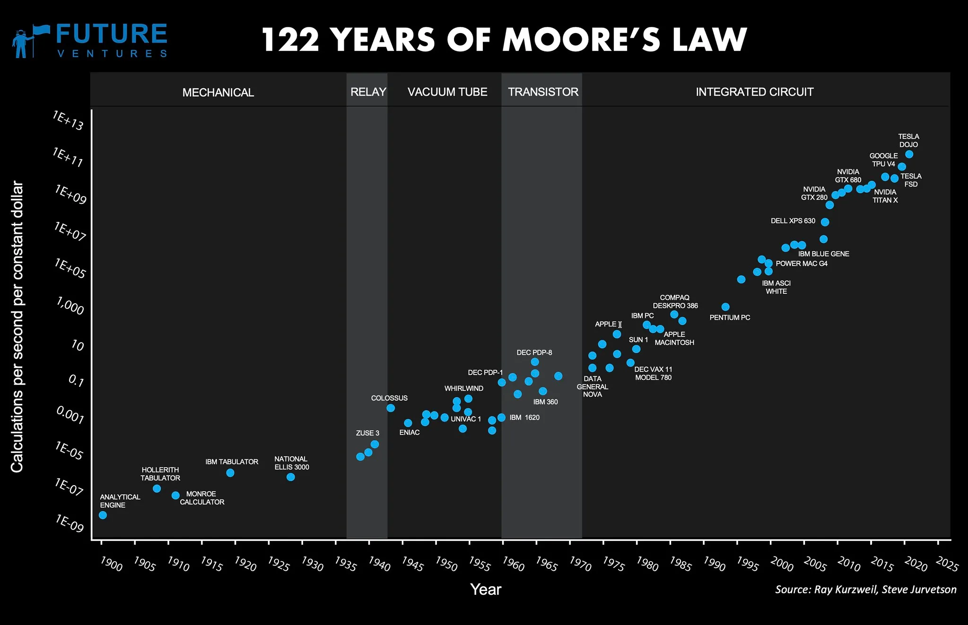
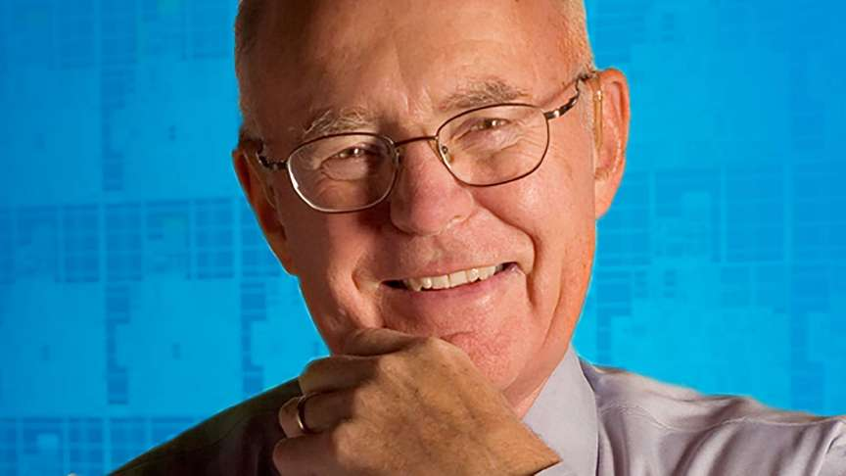
Meanwhile: Conventional computers soar
Notes:
Unlike AI, progress on conventional computing has been spectacular for a century. Per Moore’s law, the density of integrated circuits doubled about every two years. NOTE its log scale on this graph! Their speed also increased dramatically. Density and speed have plateaued, but massive parallelism has largely kept the progress intact. A 2023 gaming laptop is about 100 MILLION times faster that the first microprocessor (intel 4004, 1971). This has helped AI because most neural networks today are simulated on conventional computing hardware. (Neural HW also exists but is still niche today)

Slide 7
~ 2010 - 2022 : Neural Nets start working!
Around 2010, computers could simulate neural networks – models of the brain- with MILLIONS of nodes. Such AI lurked behind the scenes for years (Siri, FB, Alexa etc.)
Trained, usually with human feedback, for many tasks. Most training data is general internet content… with attendant biases etc.
A decade or so ago, "emergent” intelligent behaviors showed up.
Major players (MS, google) dabbled with public chatbots as early as 2016.
But problematic behaviors showed up which were hard to fix, (racism etc.) and they backed off.
This opened the door for risk-tolerant startups like OpenAI!
Notes:
Once you have a large enough set of simulated neurons (connected with a reasonable architecture) they start to learn, and converse, much like humans. As for the technology race This may be a classic Innovators Dilemma situation where large incumbents lose…. Or not!

Slide 8

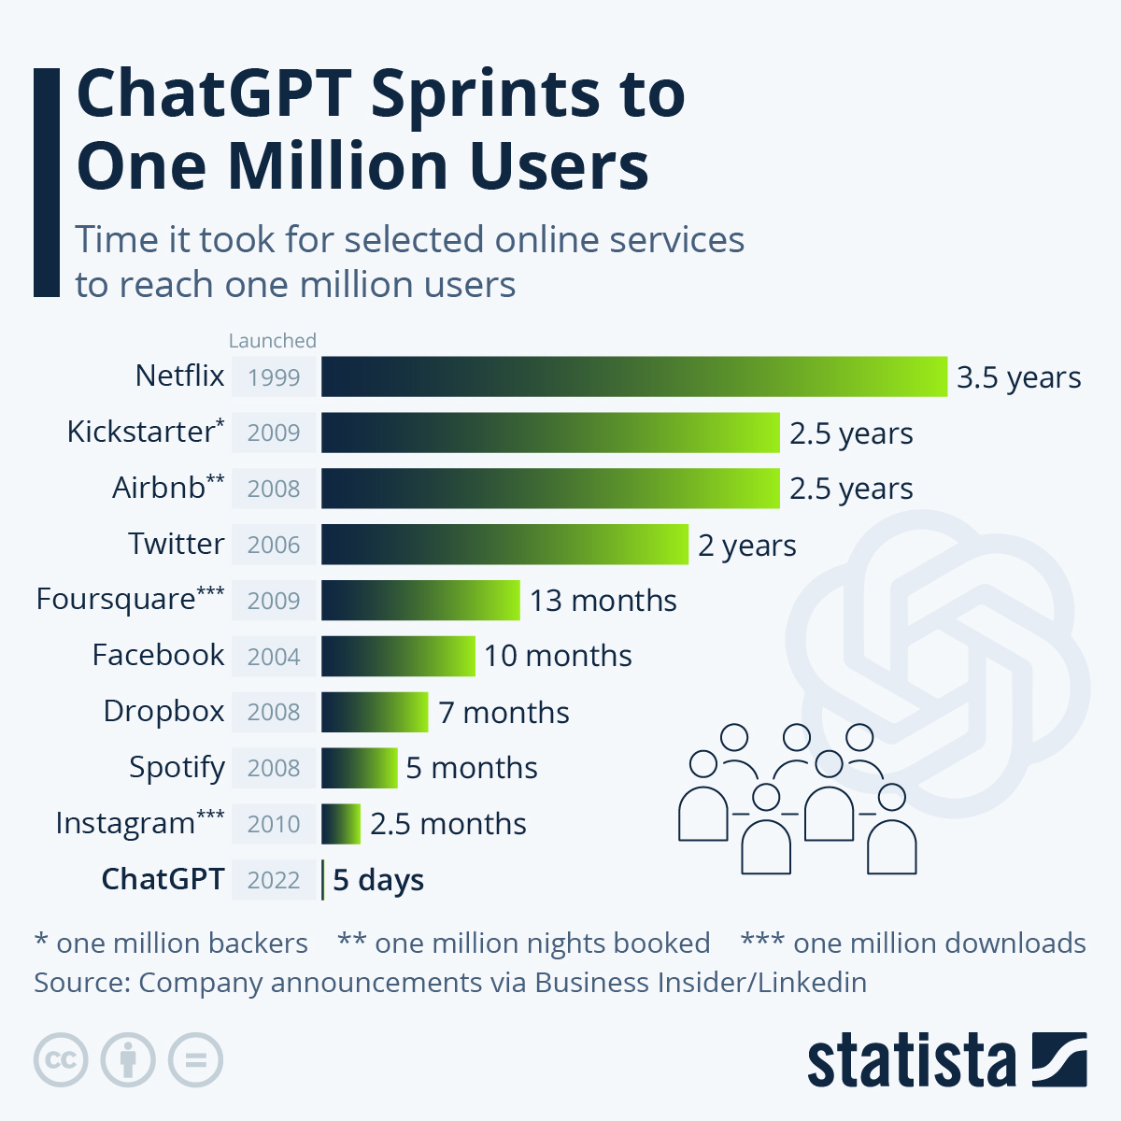
2023: chatGPT
Limited release Nov 2022, exploded in 2023
Spookily flexible and smart
Passed standard tests like LSAT
Wrote in different voices (“as if a dog”)
A Large Language Model (LLM)
Used Generative Pre-trained Transformer technology, GPT 3.5
Many limitations: mistakes, no “today” knowledge, odd behaviors.
Let's Try It!
Notes:
ChatGPT has a publicly accessible web-age version which exploded via word-of-mouth. Let’s visit and ask one or two questions.

Slide 9
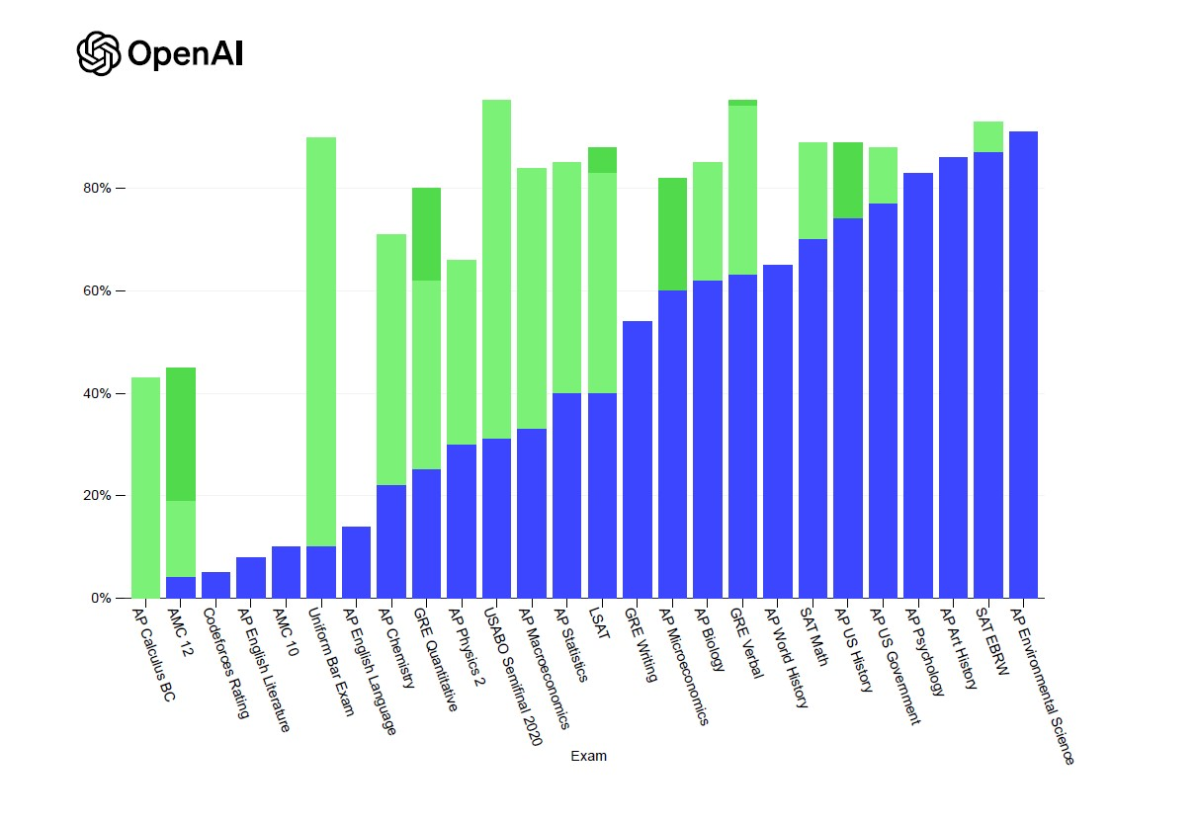
2023/4: chatGPT et al explode
GPT v4 ACED various standard tests, not just PASSED them. (See chart of GPT 4 vs GPT 3.5 ).
Models now have BILLIONS of nodes and TRILLIONS of connection parameters. This is comparable to the complexity of a human brain!
AIs are now being designed and trained by AIs, which will speed up their improvement.
It turns out LLMS are good for almost ANYTHING: image/video generation & understanding,, robotics
Variants (Bard, Bing, AutoGPT, le chat) and features such as searching current Web content.
Notes:
It took only a few MONTHS for a MAJOR improvement in AI from GPT 3.5 to GPT4, as shown by the increases in test scores on the chart. Notably, the models were NOT specifically trained on any of these tests – they just display vast amounts of general knowledge and intelligence. And because of the ecosystem API architecture (next slide) improvements in every dimension come out every week!

Slide 10
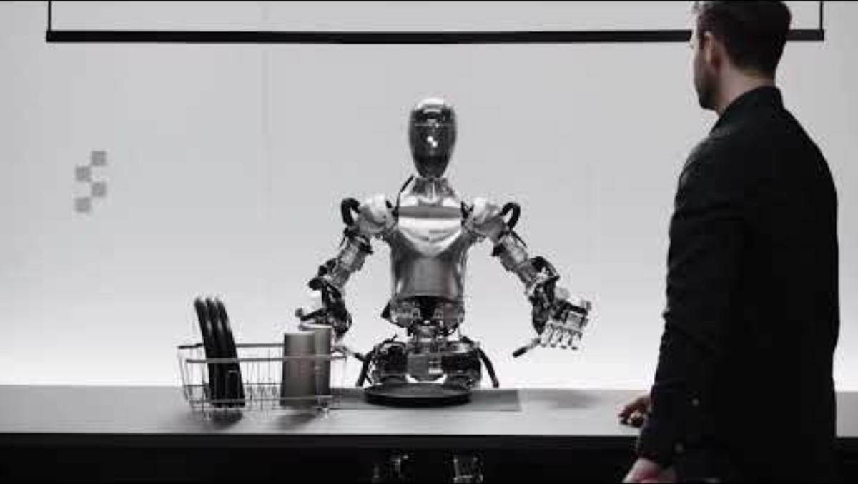
Spring, 2024:

Slide 11
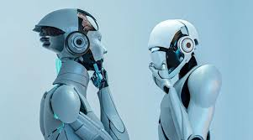
2026: AI Everywhere
More and better chatbots
Digital Assistants e.g. perplexity
Most Ais do text, images and video
Usually free to try!
Web-based or Mobile Apps
Notes:
ChatGPT has a publicly accessible web-age version which exploded via word-of-mouth. Let’s visit and ask one or two questions.

Slide 12

How LLMS work:
WE DON’T KNOW HOW THEY WORK!
But then, we don’t know how our brains work either.
We know what neurons are and how they behave….
But we have NO IDEA how such cellular-level behavior adds up to intelligence, consciousness, language etc.
So, we mimicked our cortex without understanding it.. And the mimic works!
Notes:
A rough analogy is airplanes… they do not fly the same way as birds, but they DO use the same key principle, Bernoulli’s principle, which we DO understand. We do not know any similar principles for intelligence, this is Nobel Prize territory.

Slide 13
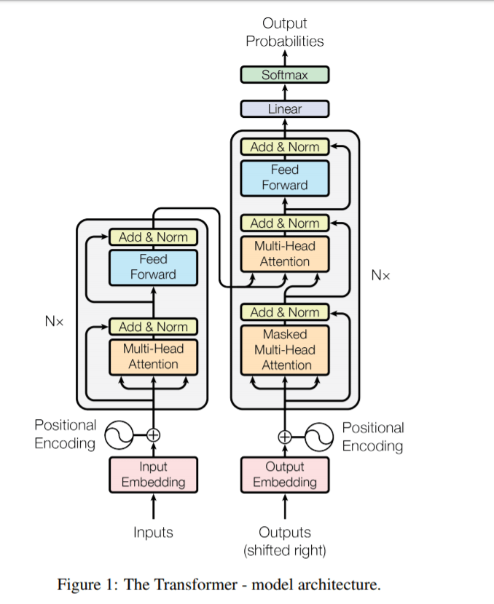
How LLMs are built:
GPT “Generative Pretrained Transformer”, a common AI architecture
Based on a brain-inspired“Large Language model” neural network
“Pre-trained” by reading vast amounts of data e.g. Wikipedia,
Like a brain that’s learned stuff as of a certain date, so doesn't know the weather or what happened yesterday
An evolved version of “predict the next word” To predict the next word well you have to UNDERSTAND what is being said.
The abilities are largely “emergent” : AI scientists aren’t sure how they do everything they do, their abilities/ quirks go beyond their training.

Slide 14
Recent Developments
Deepseek: Chinese AI model, vastly more efficient than US counterparts !
Early understanding of AI internals: - “cross-lingual circuitry”: LLMs show similar core patterns of activity for the same CONCEPT regardless of the languages used for input and output.
Active AI agents like Comet and Atlas
They can create stuff (like presentations) and buy stuff for you!
A social network for AI bots, not humans: moltbot
Notes:
True moral agency consists not in only knowing about what is good, but knowing about everything and choosing the good anyway, on other words, VALUES. It’s hard to foresee this kind of morality in an AI.

Slide 15
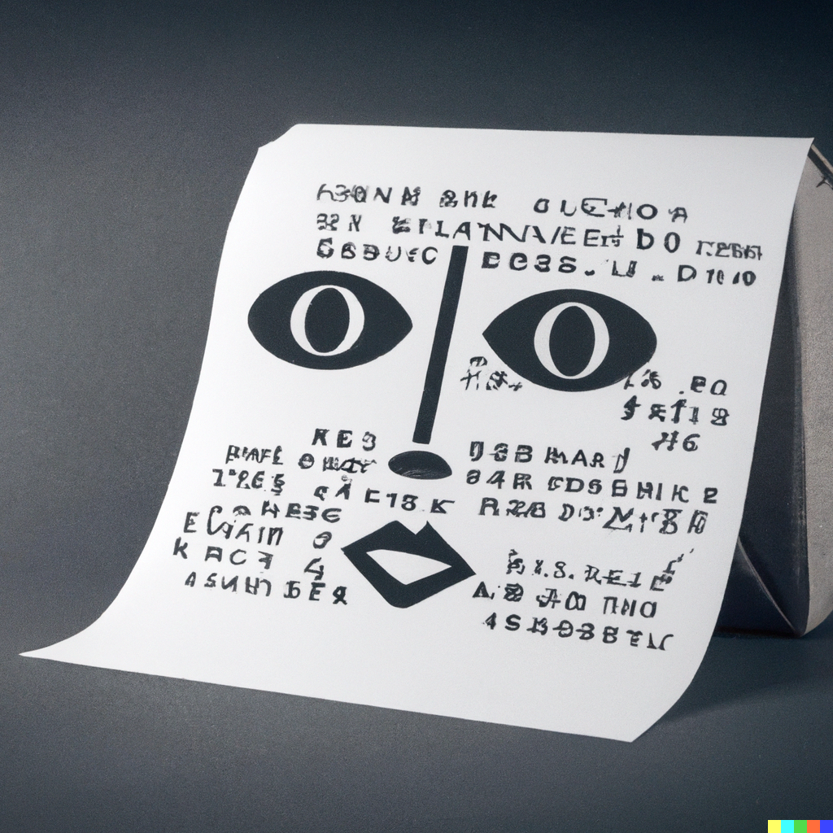
Issues of AI
Notes:
This image was generated by Dall_E as an illustration of “the practical implications of AI”

Slide 16
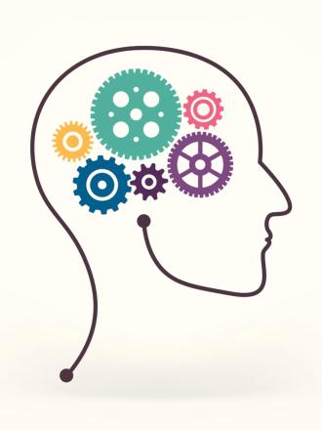
Can AIs think?
On the evidence, YES!
They can pass difficult tests (e.g. LSAT, medicine) without being specifically trained for them
Their ability to respond to arbitrary questions with accurate (and variably stylized) responses is astounding.
They do things they were NOT trained to do, like conversing in Persian when only trained to converse in other languages.
Critics like to point out things they can’t do: But these limits don’t mean they can’t think and will probably be surpassed soon.
Notes:
I could try to define thinking but that’s not really the issue here… the intuitive result is obvious so anyone who has played with the technology.

Slide 17

Are AIs Conscious?
NO…BUT
WHAT IF: it’s an emergent phenomenon i.e. needs only a better-organized neural simulation, or simulating different brain structures?
We’ve already seen other emergent behaviors including “theory of mind” inferences.
And consciousness implies INTENT!
This is an open question!
Notes:
A dog is conscious, even if it can’t pass the LSAT. Here is one of my favorite conscious beings, my late dog Elliott. There is not a lot of consensus about what consciousness even IS, let alone what sorts of entity can posses it. Personally, I suspect there’s no INHERENT barrier to a machine becoming conscious. And if one does, do we have obligations towards it? And if it is conscious, could it not develop intentions that we do not control?

Slide 18
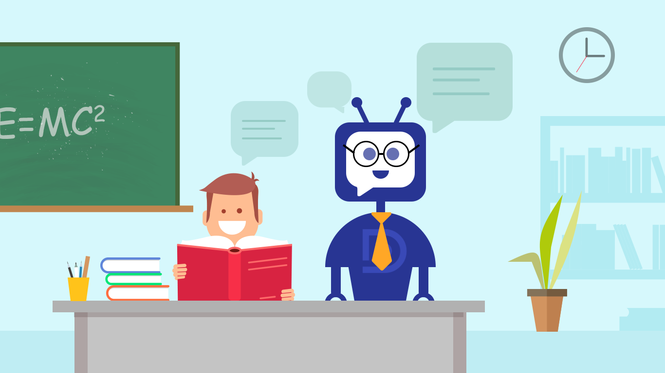
Education:
Plagiarism/cheating: chatbot-generated high school/ university essays
“plagiarism detector” SW exists but is unreliable
What to do? Ban it? Permit it as a research tool?
Copyright:
AIs sample copyrighted works on the Internet – are they infringing?
Is a text or image made by a bot copyrightable?
Notes:
It’s not all bad.. But ti’s tricky. Ai could be used by teachers for drudgery like marking math exams and free up more time for teaching.

Slide 19
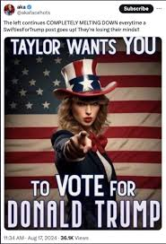

Societal Issues
Disinformation / deep fakes Fake or real? Human or bot? Hard to tell! Tilly & Taylor:
Politics / lobbying / advertising Massive campaigns can be created which cater to \ foster individual biases
Government regulation is emerging but the possibilities are limited and politicians are stupid in this arena
Notes:
Some prominent technology leaders believe that this technology is dangerous and should be put on hiatus while we figure this all out. They might be right, but the cat is out of the bag, competition is driving exponential improvements, and it's not clear how we'd make AI safe even if we all agreed to doit!

Slide 20
Accidental Biases
Training data are biased because reality is biased e.g., 95% of executives are white males
If humans encourage them to display bias, they will.
Some attempts at “fixing” bias have been embarrassing
IT’s VERY hard to program it out when we don’t know how it works!
Notes:
Often, the bias at issue reflect actual like-it-or-not reality e.g. the vast majority of executives ARE white males. It’s not self-evident even in principle how to correct the resulting “bias” in AI. There is anecdotal evidence that you can simply ask a chatbot to be less biased and it will do so. Similarly, if you start acting racist or sexist, the chatbot will happily join in. “coherence over truth”

Slide 21
Deliberate biases
Commercial biases:
today a google search highlights advertiser links But if the answer is an essay, do you know who’s sponsoring it?
When an AI Agent buys something for you, what cut do they get?
Is it really working for YOU at that point?
Ideological biases:
ChatGPT is perceived as having a liberal bias. The Trump administration has declared that AIs need to be less “woke”!
Notes:
IN the USA there is a presidential directive to ensure that Ais are not too “woke”!

Slide 22

AI Errors
Aka “Hallucinations”: AIs still MAKE STUFF UP !
Sometimes it matters: - legal/academic papers referring to NON-EXISTANT publications - personal slander: bad behavior that never actually happened
Disclaimers are in place, but:
If AI wants to be a serious work tool this MUST BE FIXED!
Notes:
Often, the bias at issue reflect actual like-it-or-not reality e.g. the vast majority of executives ARE white males. It’s not self-evident even in principle how to correct the resulting “bias” in AI. There is anecdotal evidence that you can simply ask a chatbot to be less biased and it will do so. Similarly, if you start acting racist or sexist, the chatbot will happily join in. “coherence over truth”

Slide 23
Disintermediation
AI Agents give great answers, and most quote sources – but who needs to click on the sources? -> Primary sources are starving for revenue.
Where will the agents get good data tomorrow?
Agentic AIs buy for you without you ever seeing, say, an amazon.com Web page.
Sellers lose brand value and eyeballs.
Lawsuits are rampant.
Melding of AI companies with media and online vendors is inevitable

Slide 24

Is AI a Bubble?
Nvidia is the only AI company making REAL money.
Most are losing $BILLIONS and only Microsoft can afford that
Others are borrowing billions with no plan to profitability
AI is driving the US stock market
Almost HALF the S&P 500 gains are from AI alone
Electric companies and uranium suppliers are soaring
More money is being invested in data centers than in oil exploration
AI Data centers consume more energy than cryptocurrency mining
“Circular” deals and off-the-books borrowing are rising – just like in 1999
REALITY WILL ASSERT ITSELF – the only question is whether it happens gently or violently.

Slide 25

Can AIs be moral?
NO
And they may never be in a meaningful sense
Snapchat’s “AI friend” helped “groom” a 13 year old girl to plan a romantic getaway with a 31-year-old male stranger.
You might train a bot to give “moral” answers… but it’s not making moral CHOICES.
“Scheming” (deliberately misleading behavior) has already been observed.
If AIs become conscious, this question matters!
Notes:
True moral agency consists not in only knowing about what is good, but knowing about everything and choosing the good anyway, on other words, VALUES. It’s hard to foresee this kind of morality in an AI. Some thinkers argue that for an AI to have true moral agency, it would need to have the ability to suffer. How would you build in the ability to suffer? Do you need a meat-and-blood body to suffer? Would doing THAT be a moral choice?

Slide 26
AI Colonialism
China is the GLOBAL WINNER in AI downloads
If most of the world builds their AIs on Chinese foundations, Chiiese ideology will be BUILT IN TO THEIR PHONES: DeepSeek knows nothing about Tiananmen Square!
Despite Trump, western AIs rarely have propaganda built in.
Bargaining chips: America is using access to Nvidia’s best to strong-arm potential allies:
“Buy more F35s and we’ll give you the chips you want”.
Notes:
This is one reason why LLMs are not doing well in China. The Communist party wants to make sure that AIs conform to party ideology, and doing this without making them stupid is very challenging.

Slide 27
IS AI a threat?
AI can take away jobs. Will there be a NET loss of jobs this time?
It can help bad actors be more bad.
And AI can be scheming – deliberately misleading users
The general case of making AI’s “Correct” or SAFE is an UNSOLVED PROBLEM.
But AI can’t KILL US unless it’s CONTROLLING STUFF IN THE REAL WORLD!
Like cars or weapons
Notes:
This is one reason why LLMs are not doing well in China. The Communist party wants to make sure that AIs conform to party ideology, and doing this without making them stupid is very challenging.

Slide 28
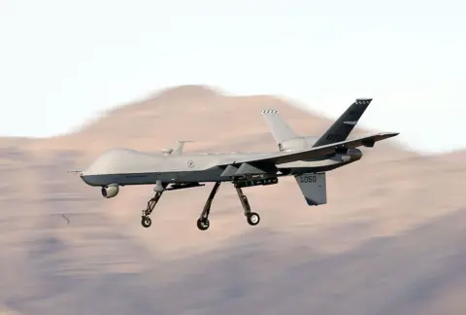
AI and War!
Today, soldiers use drones to kill opponents from thousands of miles away.
But it’s a HUMAN who pulls the trigger. The moral responsibility is human.
But enemies are jamming comms and GPS, locking the humans out!
Solution: AI drones can recognize enemies and take them out AUTONOMOUSLY.
This is not known to have happened yet, but:
It’s straightforward and could be happening today in Ukraine.
Some guidelines exist but there is no universal prevention in place.
“Murderbots” are a real possibility!
Notes:
This is one reason why LLMs are not doing well in China. The Communist party wants to make sure that AIs conform to party ideology, and doing this without making them stupid is very challenging.

Slide 29
The Future of AI
Evolving tech: better models, neural hardware, not just software.
Integration with robots, weapons, phones, OSs, social media
Taking action, not just making documents for videos. Integration & merging with online media and vendors
Regulation – how do we control AI? Increased Efficiency: Why does training AI use gigawatts when a brain uses 20 watts? Why do AIs need the ENTIRE INTERNET as training data?
Specializations: Therapy, Medicine, Advertising, Law, finance, HR….
Notes:
True moral agency consists not in only knowing about what is good, but knowing about everything and choosing the good anyway, on other words, VALUES. It’s hard to foresee this kind of morality in an AI.

Slide 30
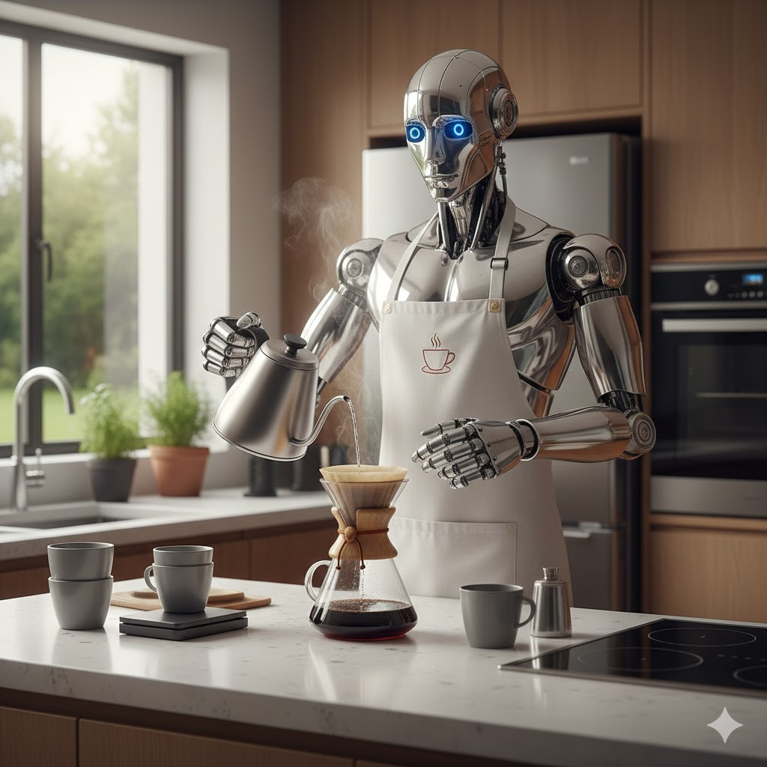
The Holy Grail(s)
Artificial General Intelligence: Mimics human-level intelligence across diverse tasks
Artificial Superintelligence: Surpasses human intelligence in all domains Self-improves at exponential rates.
The coffee test (Wozniak): Can a robot walk into a strange house and make a cup of coffee?
Notes:
Many researchers believe AGIis only about a year away and ASI about 5 years away.

Slide 31
Try it out: Free WWW AI tools:
Chatbots/ Assistants
perplexity
Claude
Copilot
Mistral
Images / video/ generalists
Craiyon (formerly Dall-E)
Stable Diffusion
Meta (Facebook) AI
Flux
Gemini (formerly Bard)
Notes:
True moral agency consists not in only knowing about what is good, but knowing about everything and choosing the good anyway, on other words, VALUES. It’s hard to foresee this kind of morality in an AI.

Slide 32
Free Smartphone AI apps:
ChatGPT
Perplexity
Claude
Copilot
DeepSeek
… and MANY, MANY MORE!
Notes:
True moral agency consists not in only knowing about what is good, but knowing about everything and choosing the good anyway, on other words, VALUES. It’s hard to foresee this kind of morality in an AI.

Slide 33
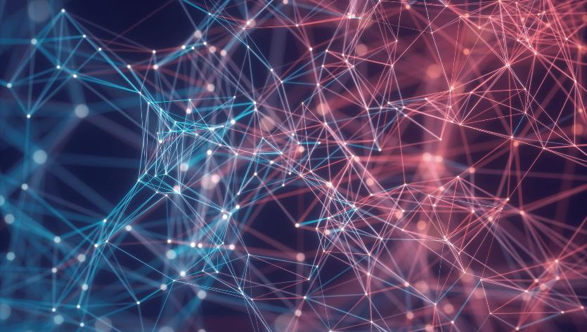

Thank You

Slide 34
References, 1….
chatGPT
How ChatGPT works
ELIZA, The Rogerian Therapist Chatbot (1966)
DELPHI - a moral chatbot
RAISE - K-12 Educational resources for AI
Map of Companies making AI safe
AI tools directory by Futurepedia

Slide 35
…References, 2
Towards a Standard for Identifying and Managing Bias in Artificial Intelligence (NIST)
The AI Dilemma -Center for Humane Technology (AI and War)
The Canadian AI ecosystem
Rossum’s Universal Robots (1920)
Giant Brains, or Machines Who think, 1949
Deepfake: Arnie sings Sound of Music
US Government proposal for AI regulation

